Slide 1

Booking Data Analytics Hotel Chain C
Group AA - Addex Consulting
Anastasiia Tagiltseva (m20200041)
Doris Macean(m20200609)
Doyun shin (m20200565)
Emil Ahmadov (m20201004)

Slide 2

Business Objectives
Cancellation & Overbooking Balance
Cancellation Forecast
Reduction of cancellation rate to 20%
Characteristics & Cancellation Correlation

Slide 3
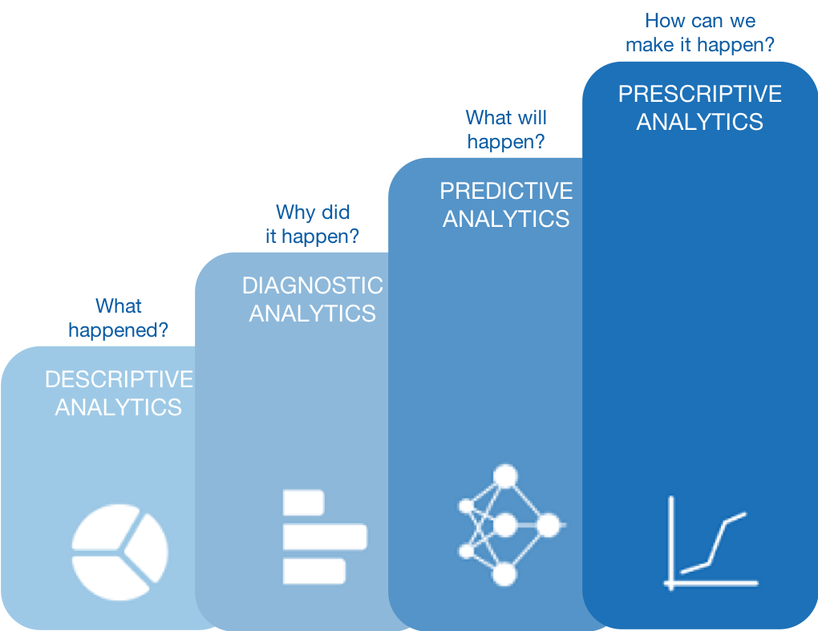
Predictive Analytics Process

Slide 4
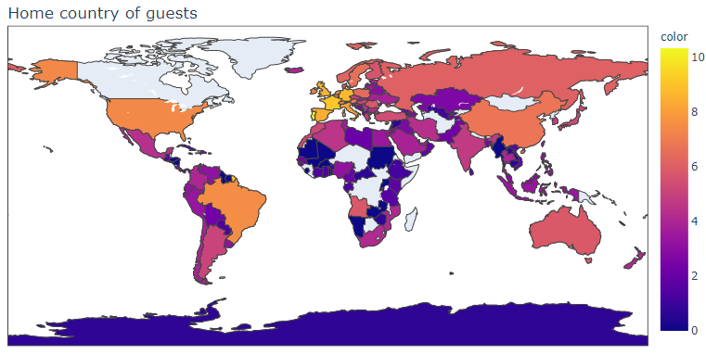
Descriptive Analysis
Cancelled Not Cancelled

Slide 5
Diagnostic Analysis

Slide 6


Additional Features
Cancellation Rate
Special request
Wants parking spot
If a person made a booking change
Waited in waiting list more than a day
Assigned room is different than reserved room
Travels with family or not

Slide 7

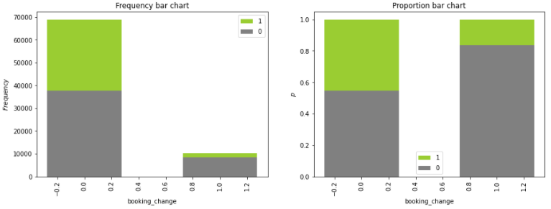
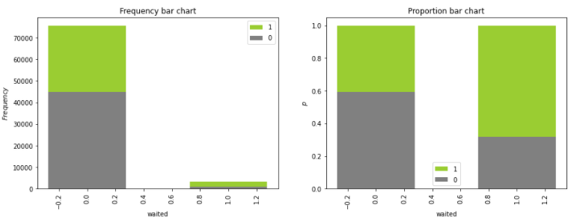
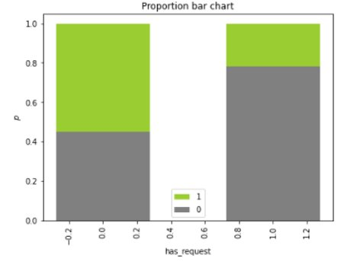
Additional Features Highlight
Booking Change
Waited
Special Request

Slide 8

Predictive Model

Slide 9

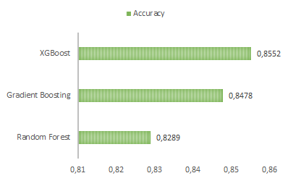
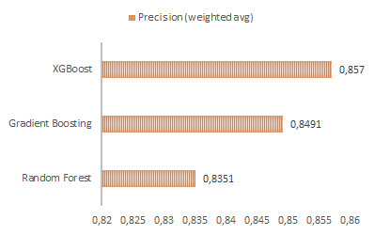

Slide 10

0.8570
0.8534
0.8552
Precision
F1
Accuracy

Slide 11

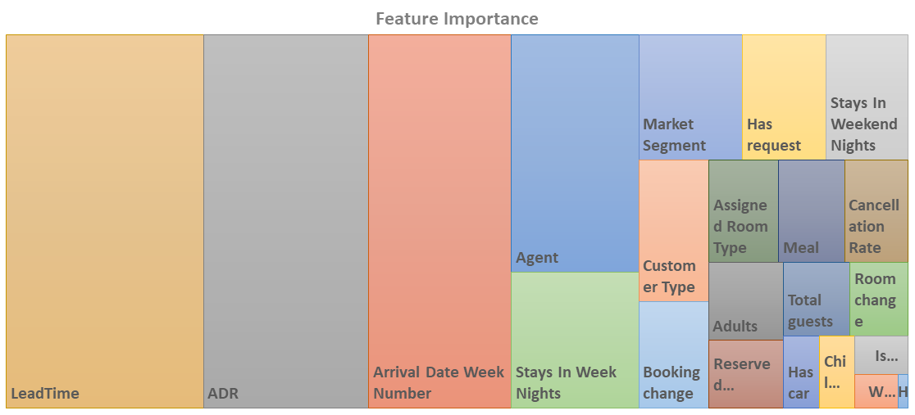

Slide 12

Pilot Program
Focused Training
On-site Support
Monthly Assessment
Full Deployment
Expanded Training
On-Site Support
Real-time Monitoring
Periodical Assessment
Future
CRM Integration
Offering Recommendation

Slide 13

Thank you.

